Slide 1
E-Books Online Web Based Application
Group 10 :
-Jasmine Nabila Novel
-Yansiska

Slide 2
System Summary
Ebooks online is one of the media providers for people who love to read books and help to keep reading the books they want online by using internet connection.

Slide 3
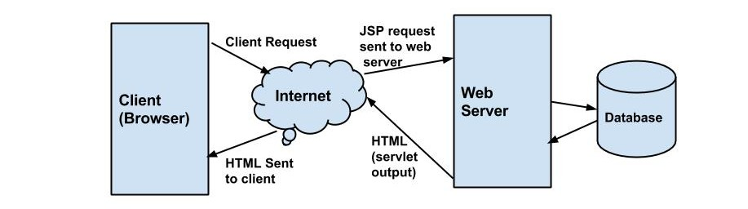
JSP (Java Server Pages)

Slide 4
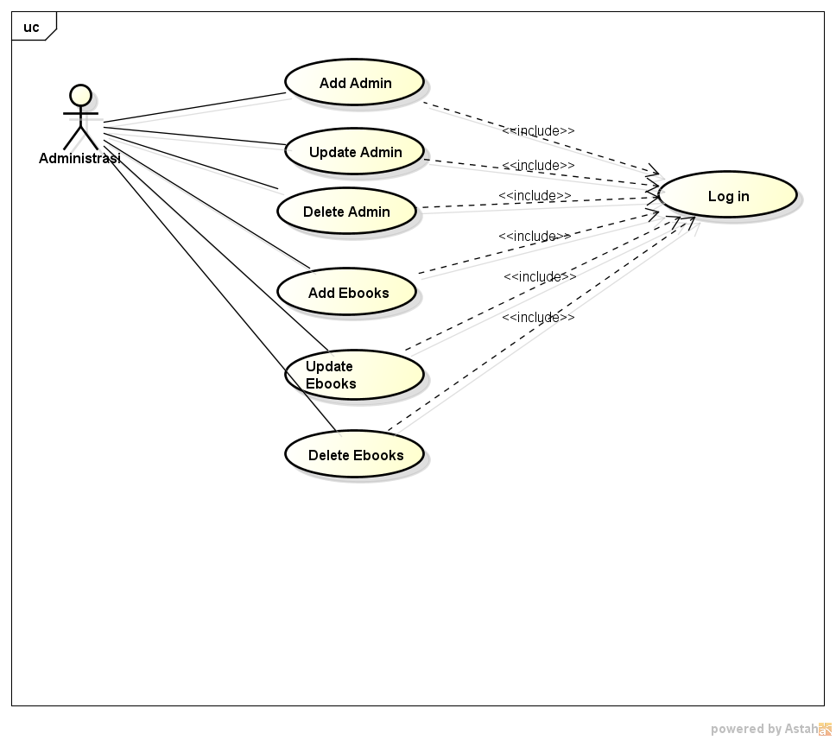
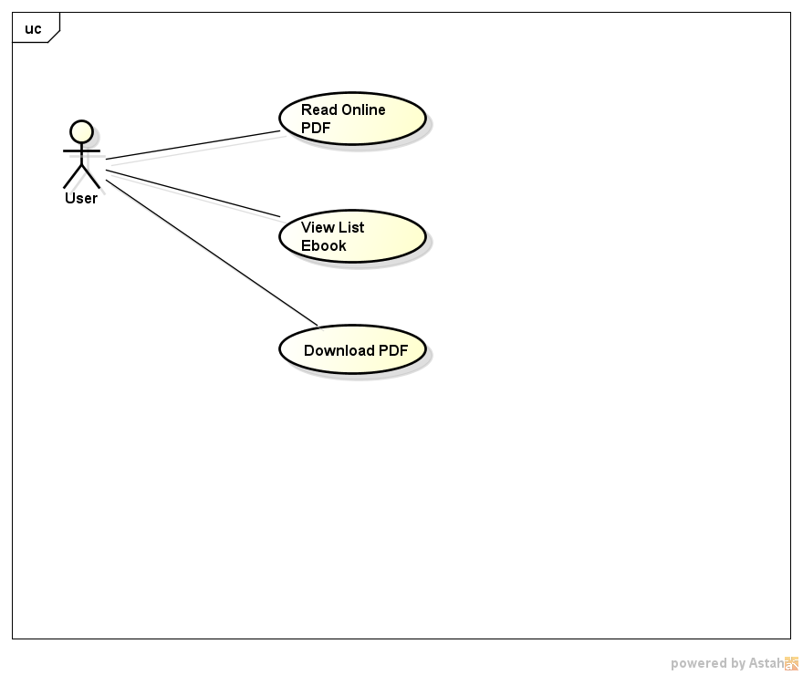
Use case diagram

Slide 5
APPLICATIONS E-BOOKS

